Slide 1


BUSINESS PROFILE
OF
Notes:
Links:
https://unsplash.com/photos/XLm6-fPwK5Q

Slide 2

We were started our journey in 2012 by some young energetic IT professionals who are still managing our concern with their high skill and dedication. In our 5 years lifetime, we have developed some powerful software applications, lots of corporate website and ecommerce platforms. Nowadays, we have extended our business in digital online marketing, security solution and computer networking and hardware support for corporate business concerns as well as Professional Courses on Web design, Networking, Graphic Design. Now we are a group of software engineers, project managers, system analysts web designer, hardware and support engineers and other inventive folk managed by a team of three equity partners. Our whole team is dedicatedly working to establish a digitalized Bangladesh through a perfect atomization and proper implementation of new technologies.
ABOUT OUR COMPANY
Notes:
Links:
https://unsplash.com/photos/nJdwUHmaY8A

Slide 3

Name of the Firm | Ultimate IT Solution
Acronym | UITS
Year of Establishment | 2009
Registered Mailing Address | Marks A. M. S. Point (4thflr), 94, Alia Madrasa Road, Chandanpura, Didar market, Chattogram.
Contact | +8801972021093, +8801983-401410
Office Phone Number | +88-031-632411
E-mail | info@ultimateit-bd.com , ultimateitbd2012@gmail.com
URL | www.ultimateit-bd.com
Type of organization | Partnership
Nature of Business | Software Automation Company
Trade License No. | 72349
Tax Identification Number(TIN) | 813277378908
VAT Registration Number | 002048183-0503
Member of BASIS | G1003
Total Employee | 25 (Twenty Five)

Slide 4


OUR COMPANY
Based in Chittagong, we are one of the fastest growing software development companies in Bangladesh. Our main motto is to accelerate and increases the business efficiency of our clients through intelligent application of automation techniques.
WHY CHOOSE US
Customers always choose us for our following characteristics like Superb Quality, Vast Experience, Most Cost efficiency, Proper Delivery time, Seamless Long-term support, Actual Reliability and accountability, Innovation with the passage of time.
WE SPECIALIZED
We are experienced web based, distributed or stand-alone software application, which created keeping client’s business in mind. We not only develop the software but also ensure that it is smoothly embedded within your company processes.
.
Notes:
Links:
https://unsplash.com/photos/SYTO3xs06fU

Slide 5
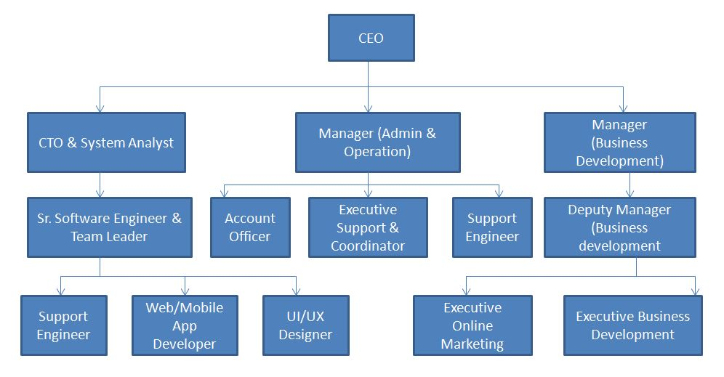
Organogram of Ultimate IT Solution
Coordinator
(Project & Support)
Deputy Manager
Engineers

Slide 6

OUR SERVICES
Custom Software Development
Apps Development
Website Design & Development
Digital Online Marketing
Domain & Hosting Service
Notes:
Links:
https://www.pexels.com/photo/person-using-macbook-pro-on-table-3987020/

Slide 7
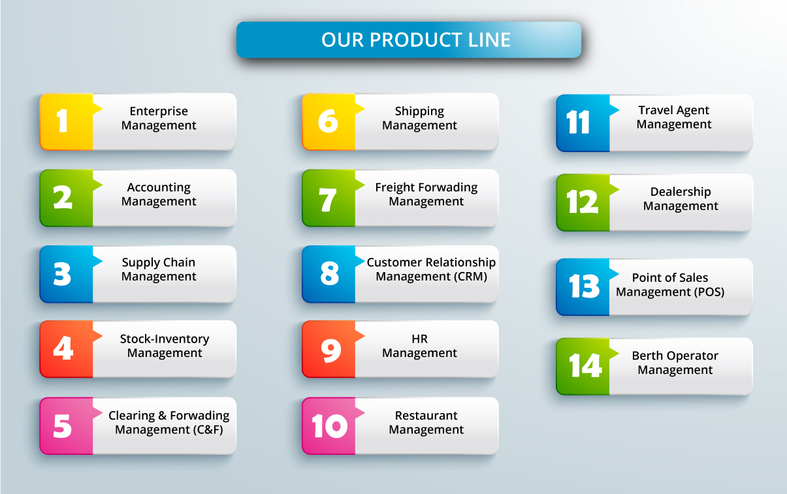

Slide 8
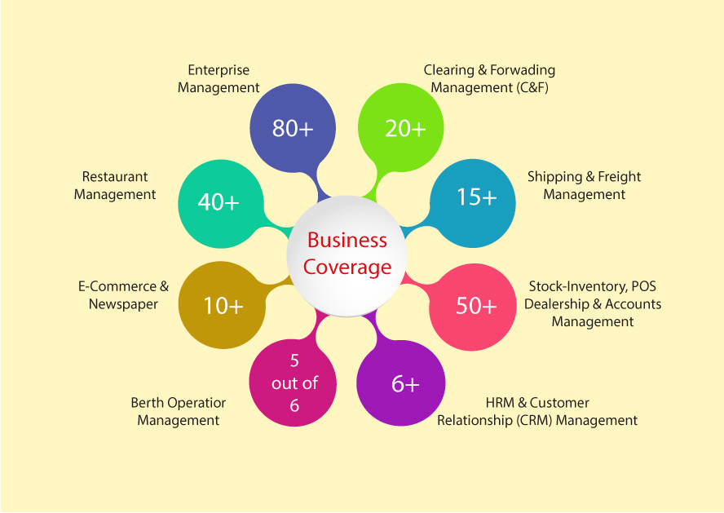

Slide 9
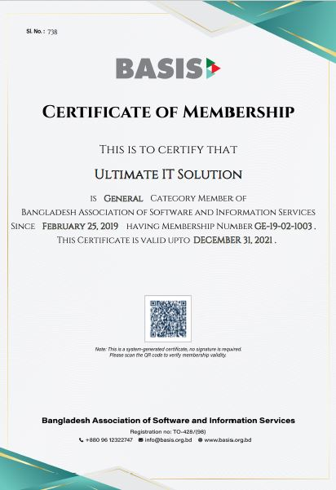

Slide 10












Our Few Valuable Clients

Slide 11












MH Chowdhury Ltd.
Fair Star Shipping line
Phoenix Shipping Ltd.

Slide 12


Slide 13
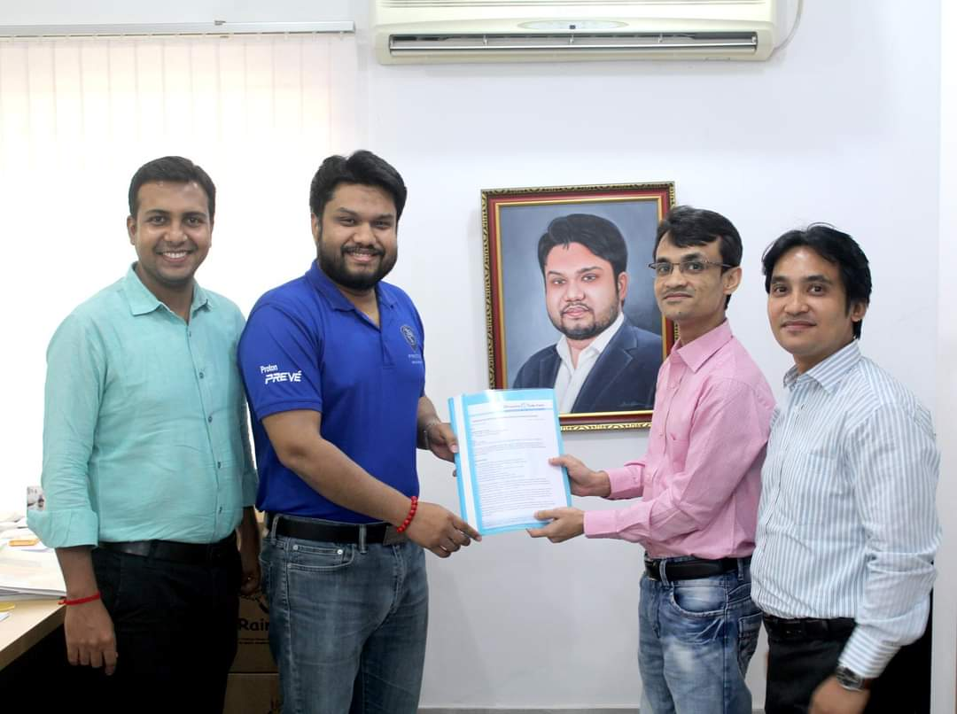
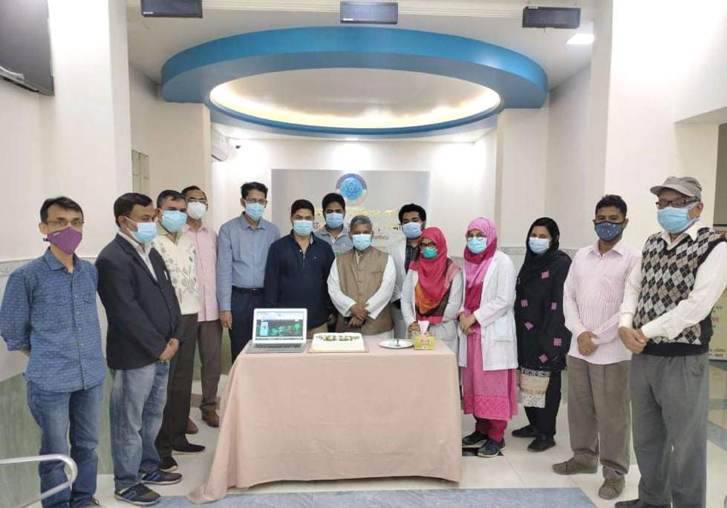
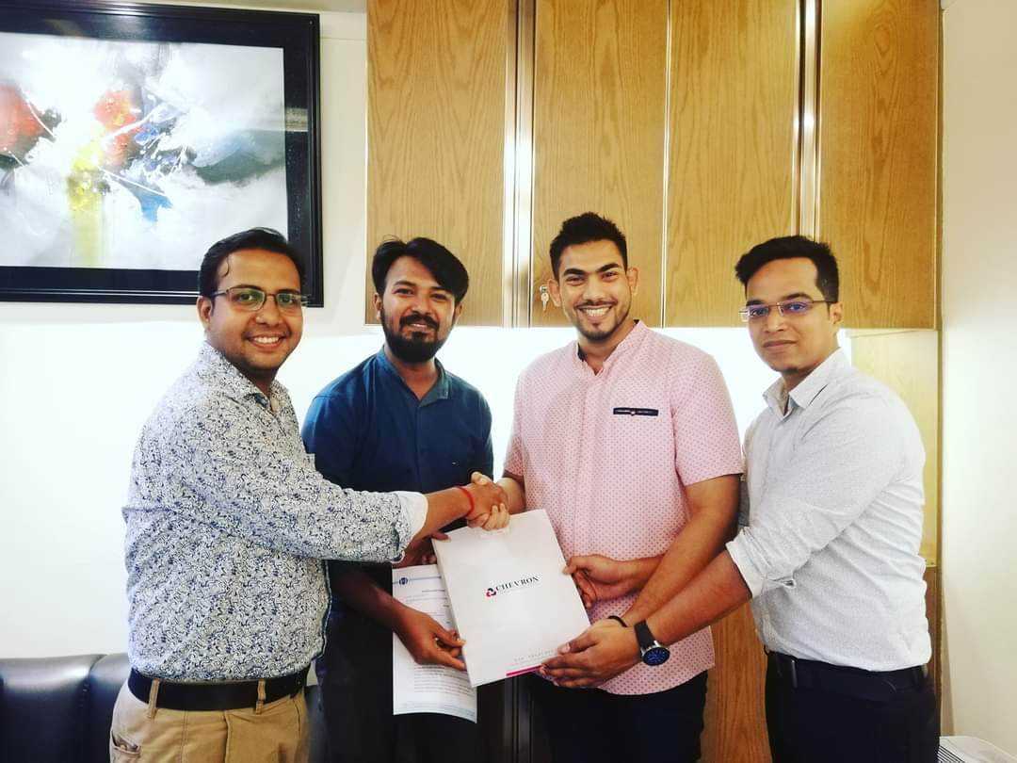
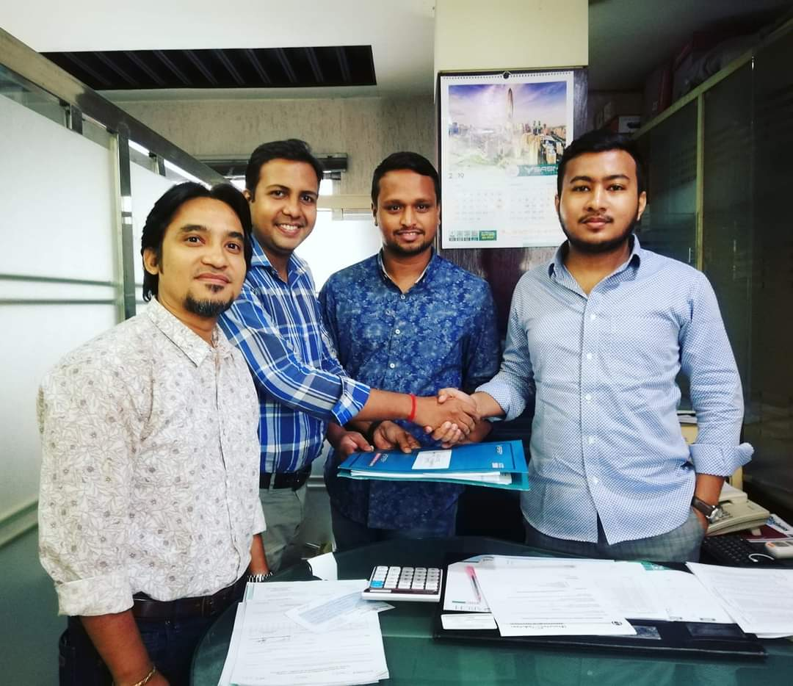
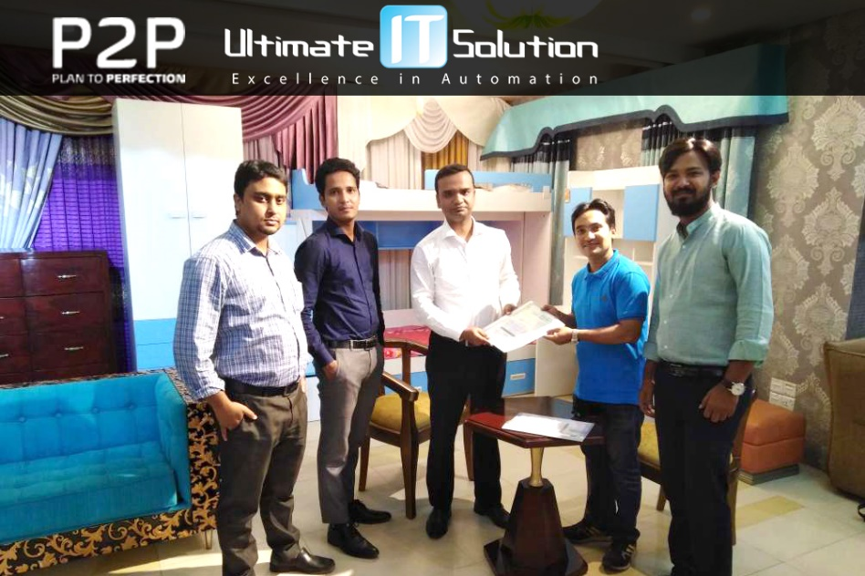
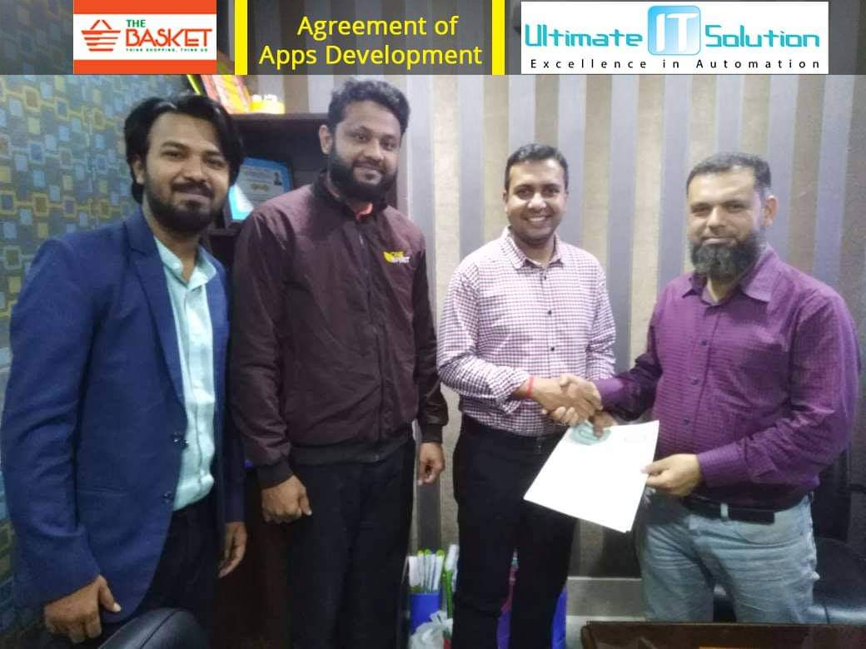
Agreement signing with PHP Automobiles
Website Inauguration program of INMAS-CTG
Agreement signing with Chevron Clinical Laboratory
Software Agreement signing with SASM
Software Agreement signing with P2P
APPS Development Agreement signing with The Basket

Slide 14
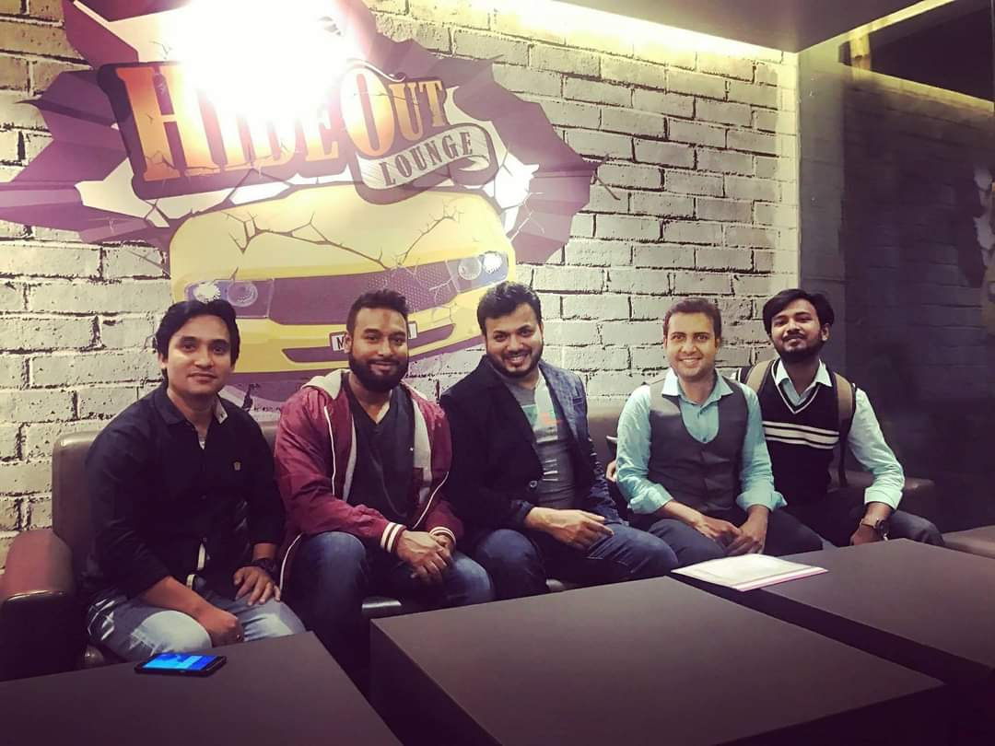
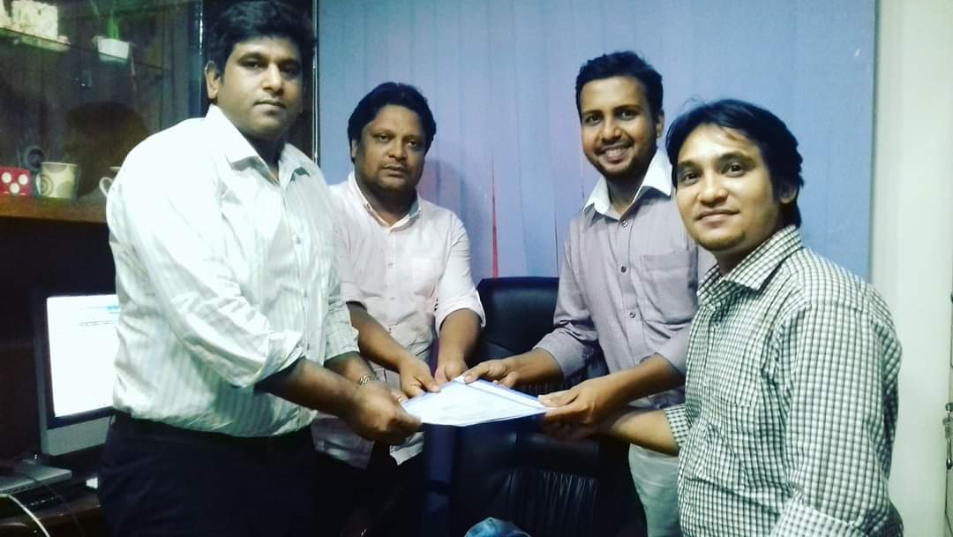
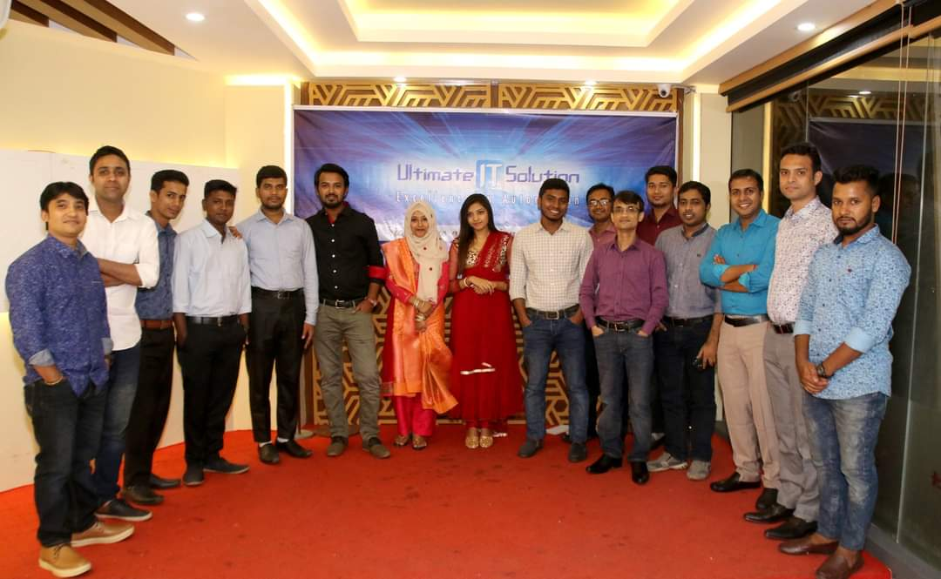
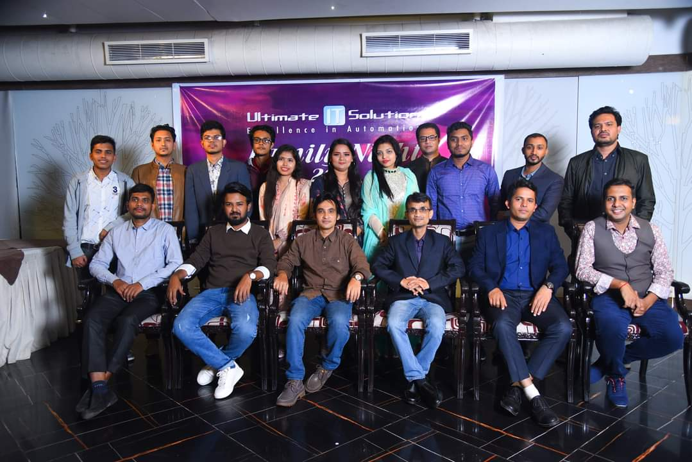
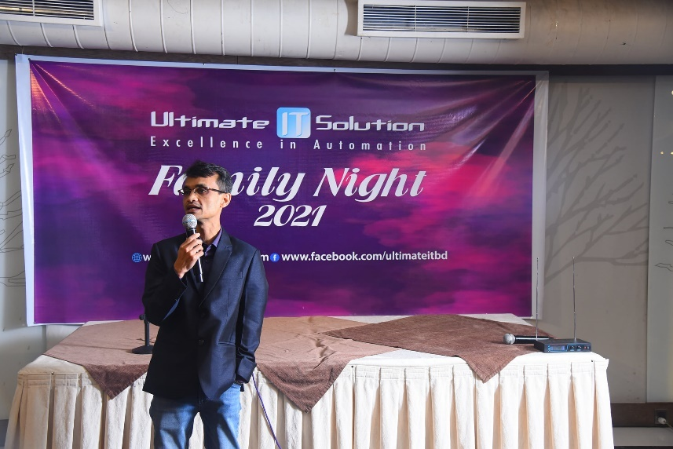
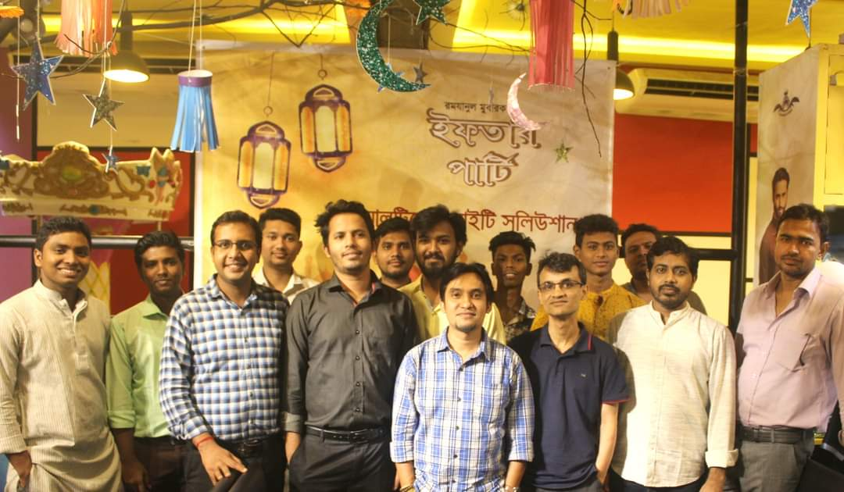

Slide 15
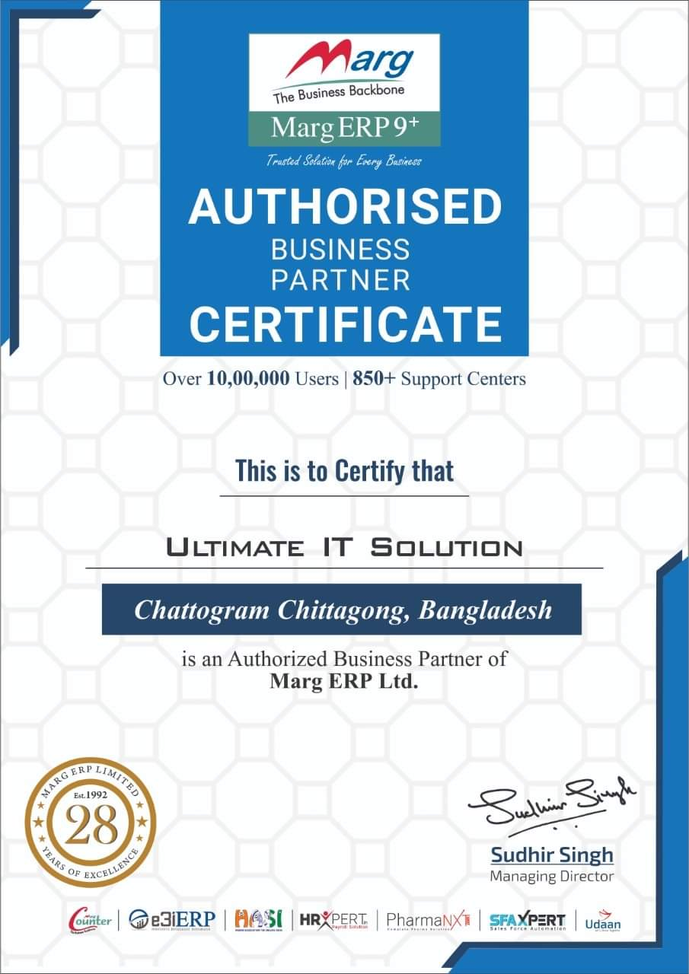

Slide 16

Contact With Us:
Address: Marks A.M.S. Point, (4th Floor), 94 Alia Madrasha Road, Chandanpura, Chittagong.
Website: www.ultimateit-bd.com
E-mail: info@ultimatit-bd.com, ultimateitbd2012@gmail.com
Phone: 031632411
Mobile: 01972-021093, 01983401410
www.ultimateit-bd.com
Notes:
Links:
https://unsplash.com/photos/XLm6-fPwK5Q

